Slide 1


REALITY & VIRTUAL
A PROJECT BY - RASYN
1

Slide 2

180204046
YUMNA ISLAM
180204073
RAHAT ASHIK
180204054
ARMAN SAKIF
180204074
M M SADMAN IBRAHIM
180204068
FARHANA AZAD
TEAM - RASYN
2

Slide 3

WHAT IS REALITY & VIRTUAL?
A location based app which will connect you to your neighbors like never before.
3

Slide 4
PROJECT OVERVIEW
Connect with people who are near you
Connecting
Interactive
Have real life interactions more. Achievements and points system make real life feel like a game
Maintains Security and safety in the neighbourhood
Security
Emergency
Urgent/emergency section enables you help from nearby people during strife.
4

Slide 5
Project Features
Admin Panel Dashboard
(Users,Employee,restaurant buddy,Ride share,Emergency Security)
Signup/Login
User
(Profile,Settings,Messages,Post Banners)
Tab
(ride, Restaurent Buddy, Help, Quests, Achievements,Map)
5

Slide 6

Survey
6

Slide 7
Project Estimation
Information Gathering
Development part
QnA
Web Hosting( for 5 years)
Web Domain(for 5 years)
Total : 153100/- BDT
7

Slide 8
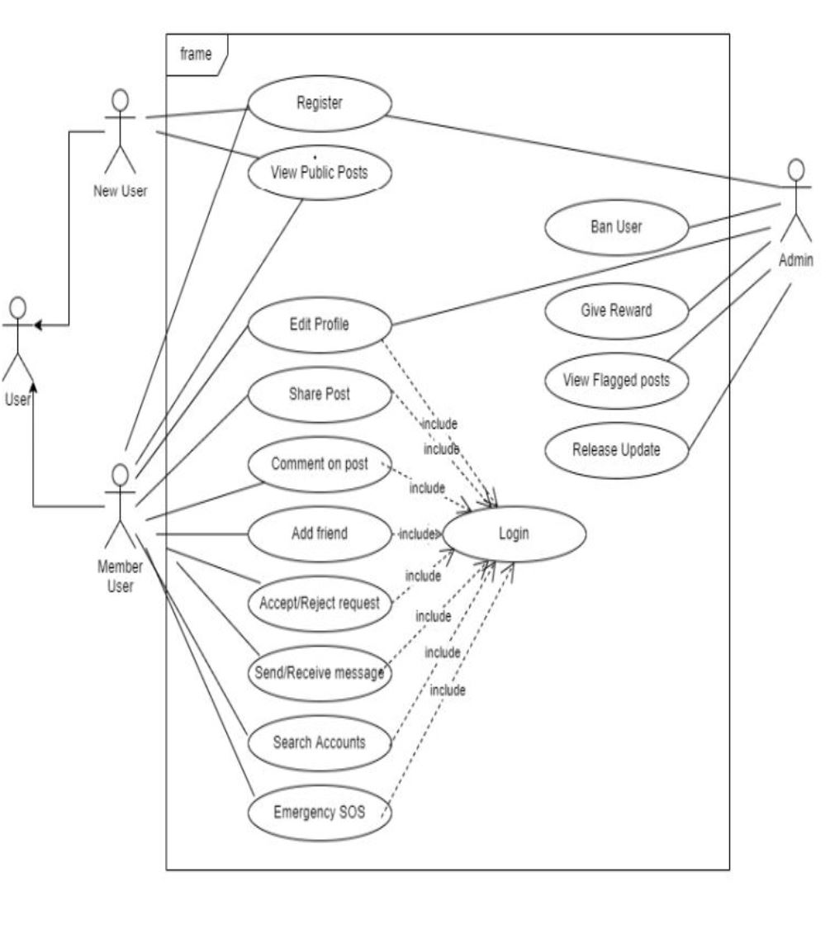
Use Case Diagram
8

Slide 9
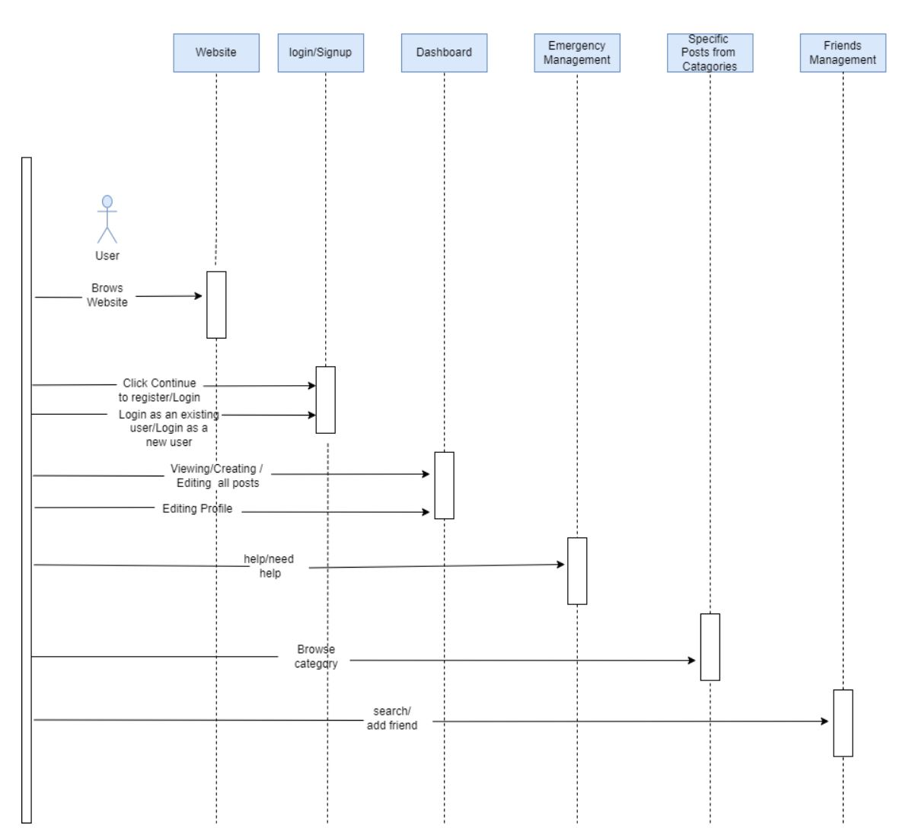
Sequence Diagram
9

Slide 10
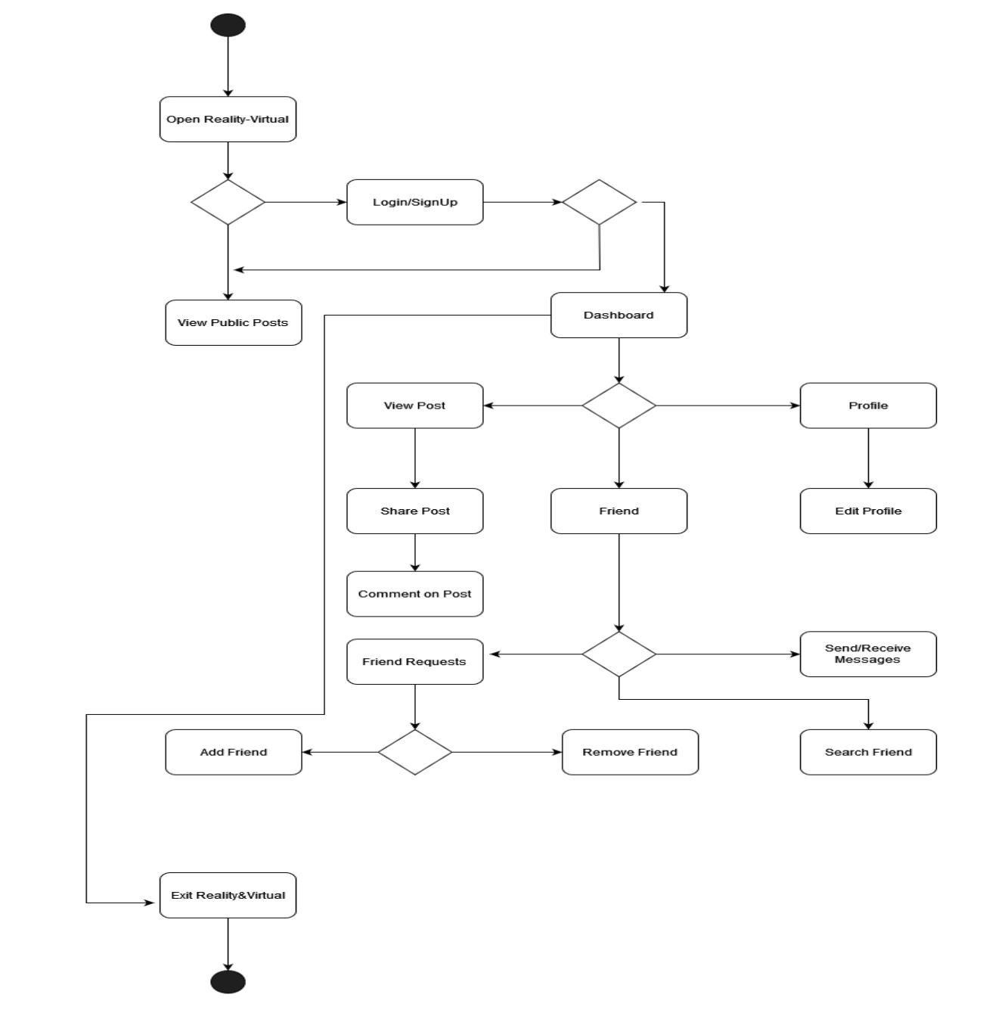
Activity Diagram
10

Slide 11
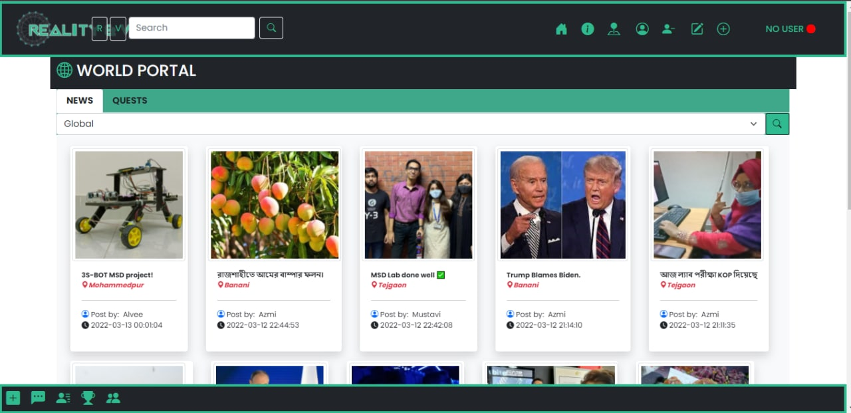
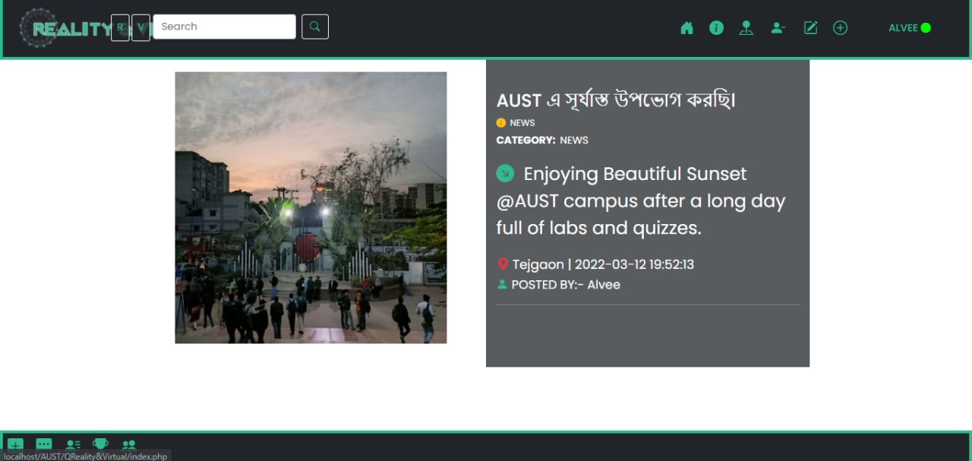
Pages
11

Slide 12
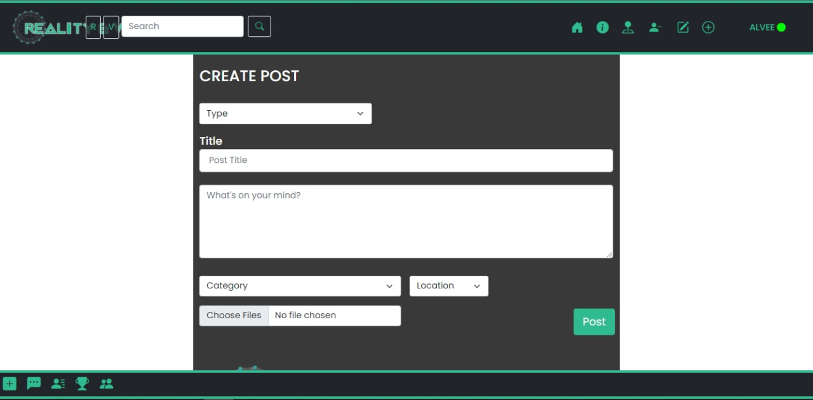
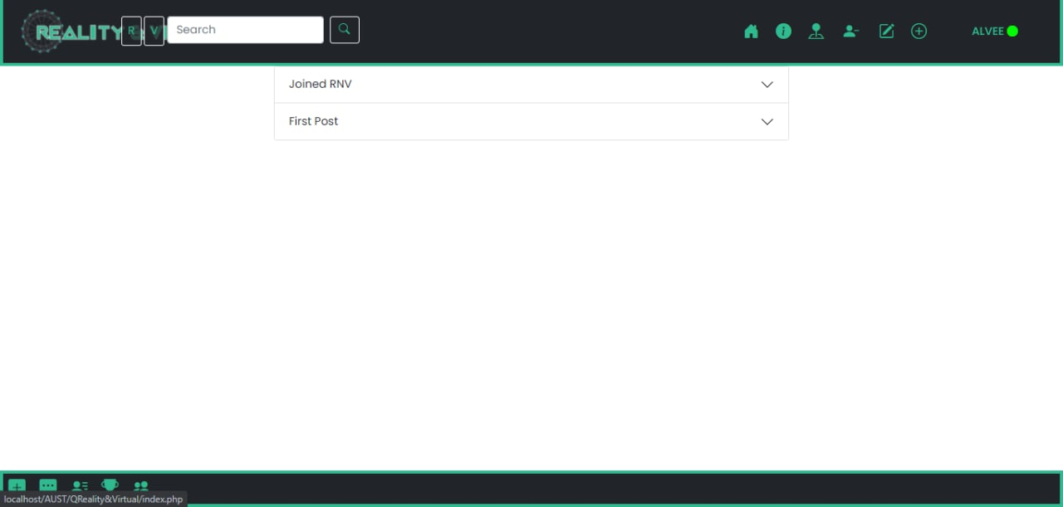
Pages
12

Slide 13
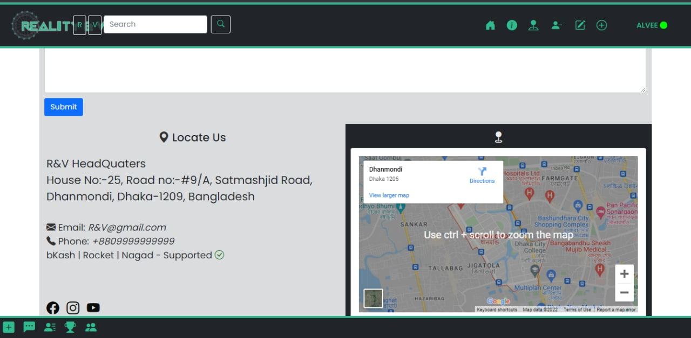
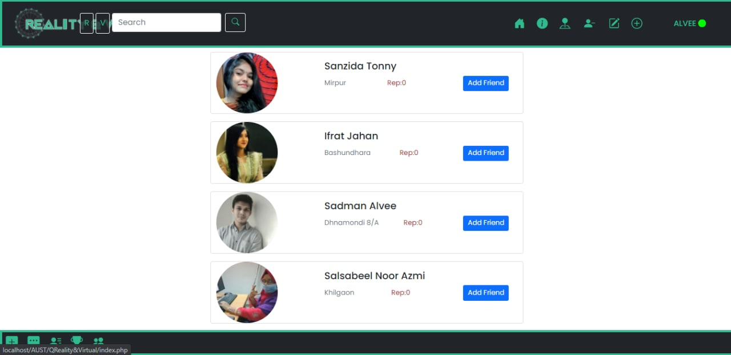
Pages
13

Slide 14
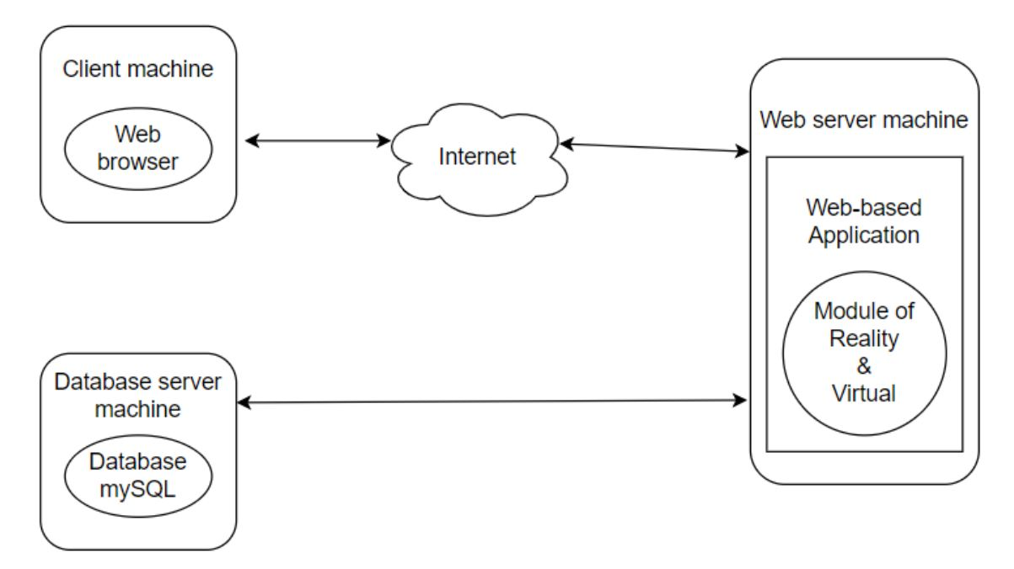
Architecture Flow Diagram
14

Slide 15
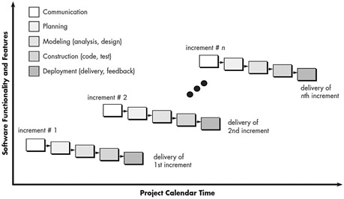
Process Model Incremental Process Model
15

Slide 16
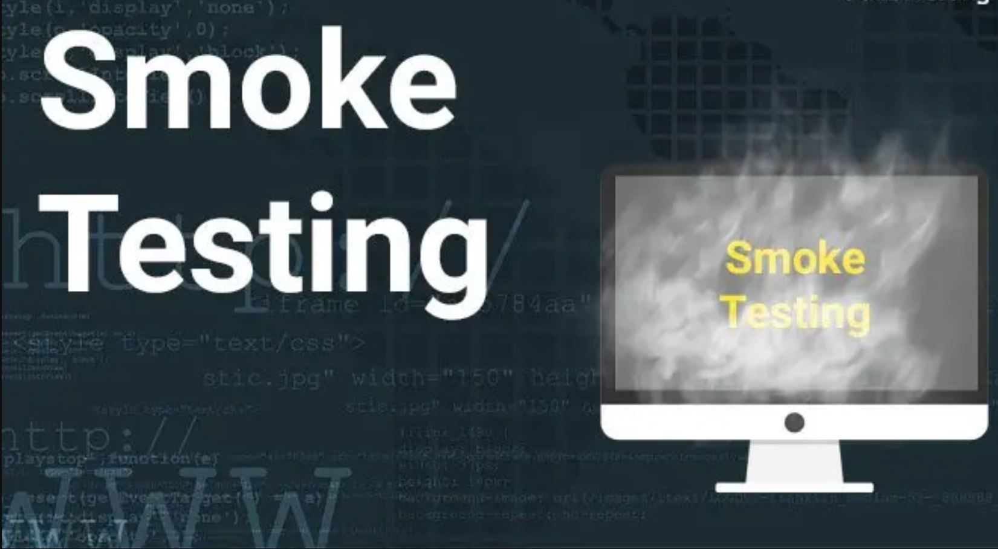
Testing Techniques
16

Slide 17

Deployment
17

Slide 18

THANK YOU
18

